Slide 1
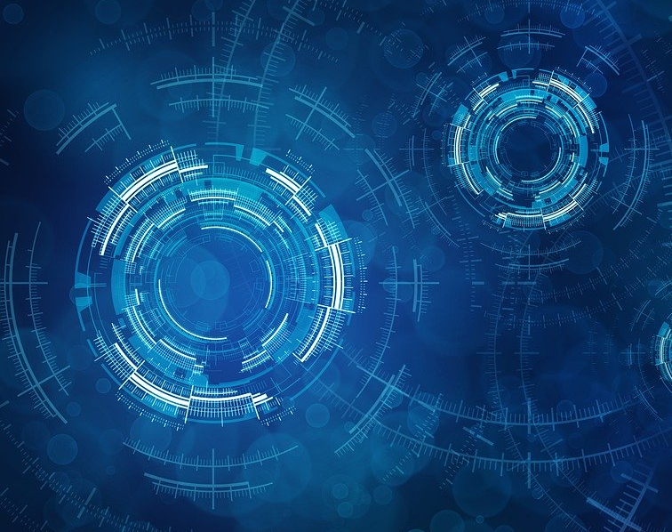
Introduction to Machine Learning with Python Pt 2
GW Coders Meet-up
March 26, 2020
By Ese Emuraye

Slide 2
Review of Session 1
Data Science Lifecycle
Overview of Convolution Neural Network for Image Classification
Introduction to PyTorch
Transfer Learning
Case study: Facemask Detector
Coding Session
Outline

Slide 3
Review of First Session
Machine Learning is the programming of computers to learn from input data
Deep Learning is a sub-field of machine learning inspired by the human brain
Supervised Learning involves learning a function that best approximates the relationship between input and output
Unsupervised Learning involves learning to infer a function/structure present within a set of data

Slide 4
Review of First Session
Neural Network is the fundamental unit of deep learning
Convolutional Neural Networks is modeled after the primary visual cortex of the brain

Slide 5
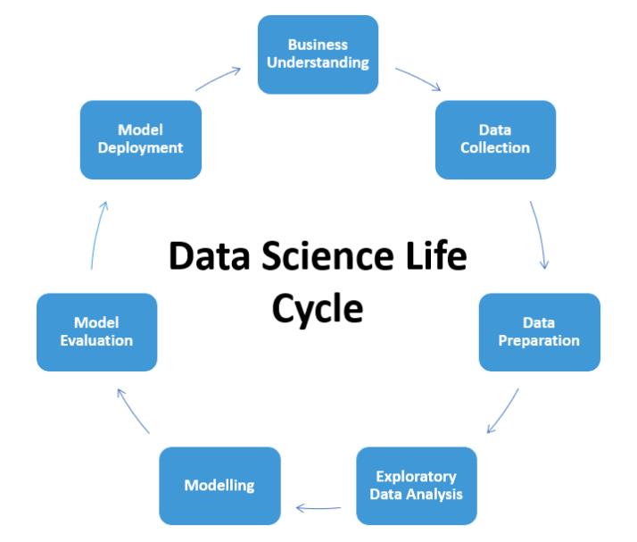
Data Science Lifecycle

Slide 6
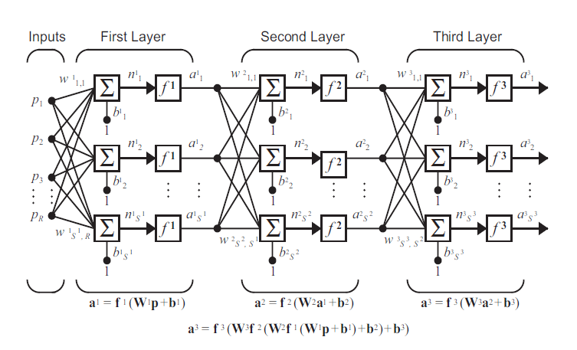
Deep Learning: Neural Network

Slide 7
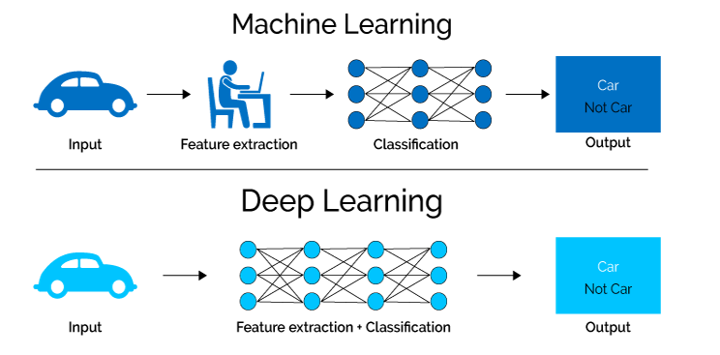
Deep Learning
It is suitable for large amount of data and features
It can easily extract features from unstructured data
It can identify very complex patterns

Slide 8
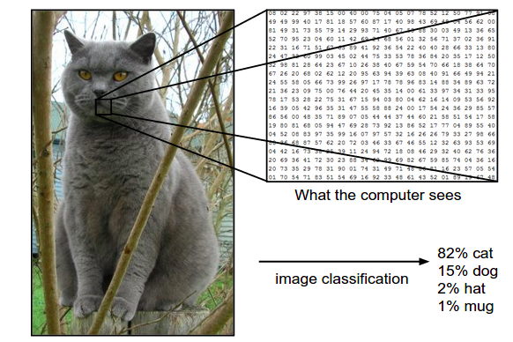
Deep Learning: Convolutional Neural Network (CNN)
It is modeled after the primary visual cortex of the brain
The complex hierarchical structure of neurons and connections in the brain play a major role in how we process remembering and labelling objects

Slide 9
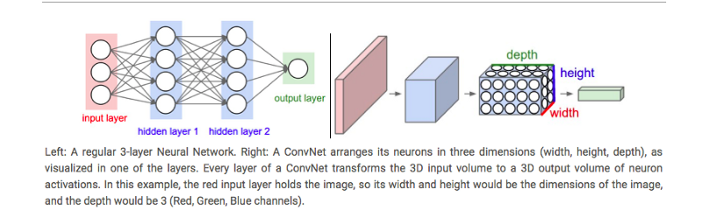
Deep Learning: Convolutional Neural Network (CNN)
The CNN Architecture consists of two parts:
The Feature Extraction part where convolutions and pooling takes place to detect features
The Classification part where extracted features are classified, with output probabilities
Normal NN
ConvNet

Slide 10

CNN for Image Classification

Slide 11

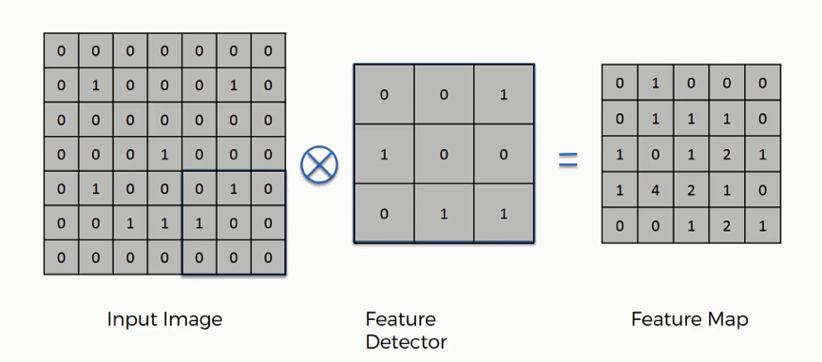
CNN for Image Classification
Feature Extraction:
Convolution layer
Pooling layer
Padding
Striding

Slide 12

Deep Learning: Training a CNN
Optimization (gradient descent)
Backpropagation
Feedforward pass
Calculation of error

Slide 13



Introduction to PyTorch
PyTorch is an open-source machine library developed by Facebook AI Research Lab
Suited for deep learning applications and research
Comprehensive documentation at PyTorch
Tensor is a data structure optimized for GPU performance
CUDA library allows you to use CUDA-enabled GPU for parallel computing

Slide 14
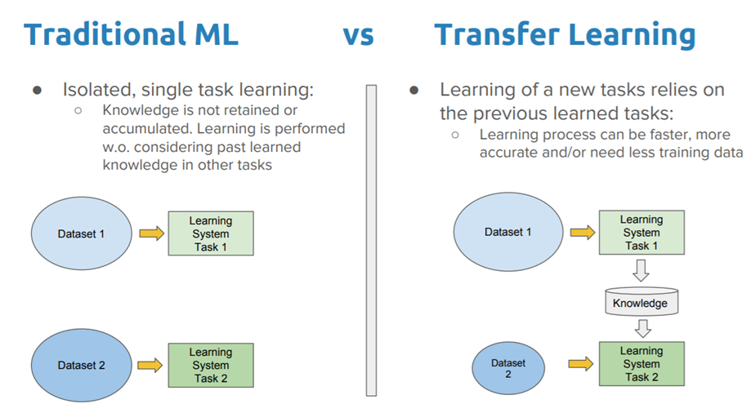
Transfer Learning
Transfer learning is a machine learning technique where a model developed for a task is used as a starting point for another

Slide 15


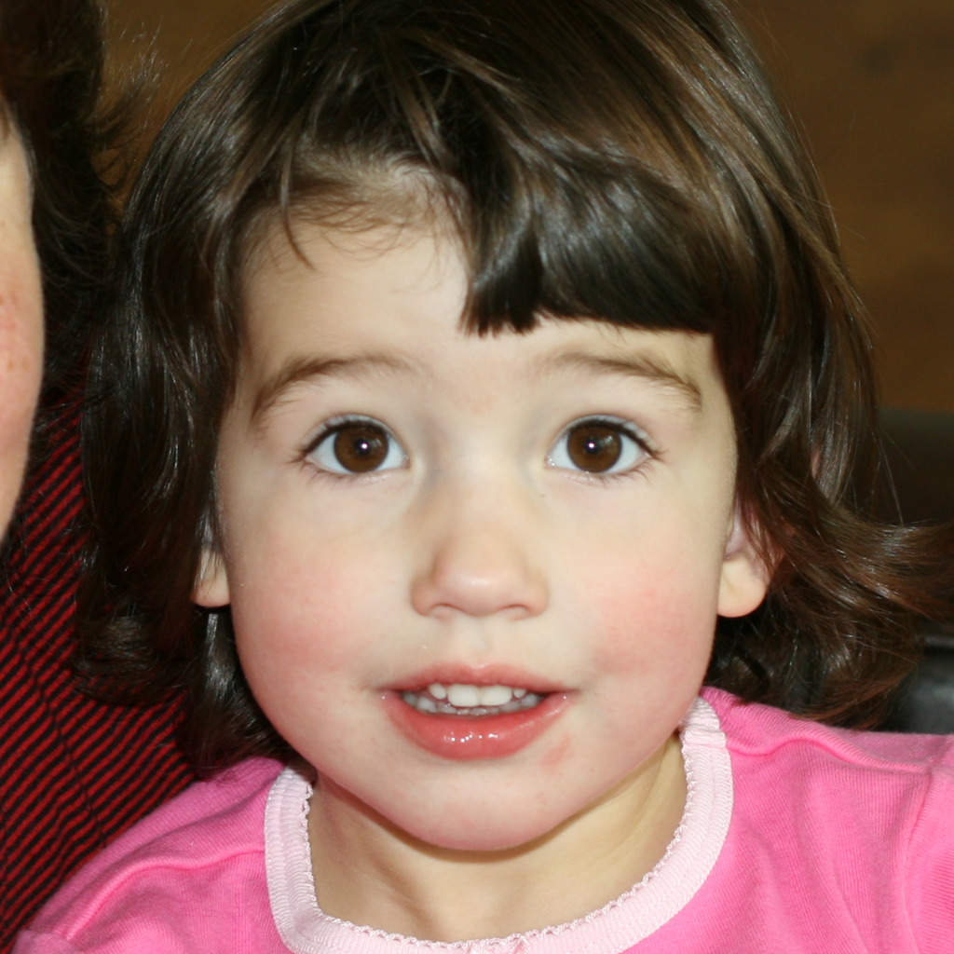
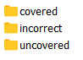
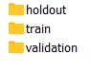
Case Study: Facemask Detector
Objective
To build a model to identify whether a face image is wearing a mask correctly, incorrectly or none
Dataset
A synthesized dataset called MaskedFace-Net

Slide 16
Steps for Training an Image Classifier
Load and preprocess data
Explore data
Build model architecture
Define optimizers and hyperparameters
Train model
Forward pass
Calculate loss
Update weights using backpropagation
Save Model
Evaluate Model
Inference

Slide 17
Questions

